Slide 1
Database Systems
Lab 05

Slide 2
OBJECTIVES:
CARTESIAN PRODUCT
PRIMARY KEY AND FOREIGN KEY CONCEPT
Types of joins
Inner join
Outer join
Left outer join
Right outer join
Full outer join
Self join

Slide 3
LEARNING OUTCOMES
AT THE END OF THIS LAB STUDENT WILL BE ABLE TO KNOW:
ABOUT THE CONCEPT OF PRIMARY KEY AND FOREIGN KEY
HOW TO RELATE MULTIPLE TABLES IN SQL
SET OPERATORS

Slide 4
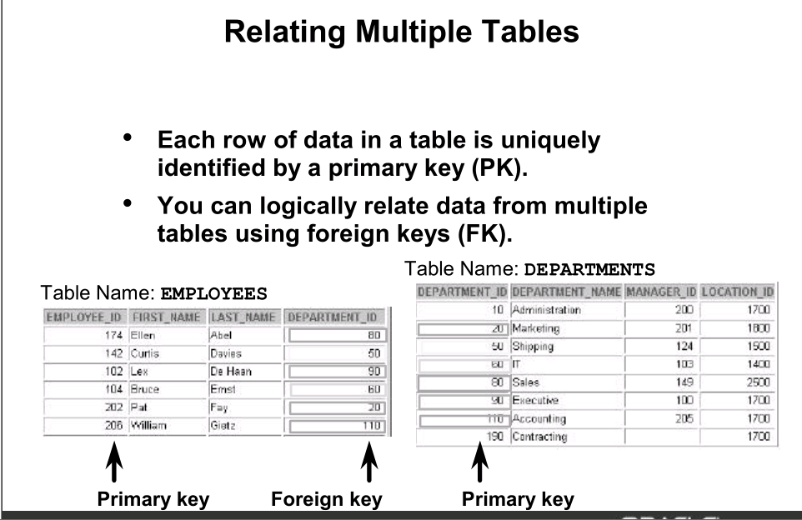
PRIMARY KEY AND FOREIGN KEY CONCEPT

Slide 5
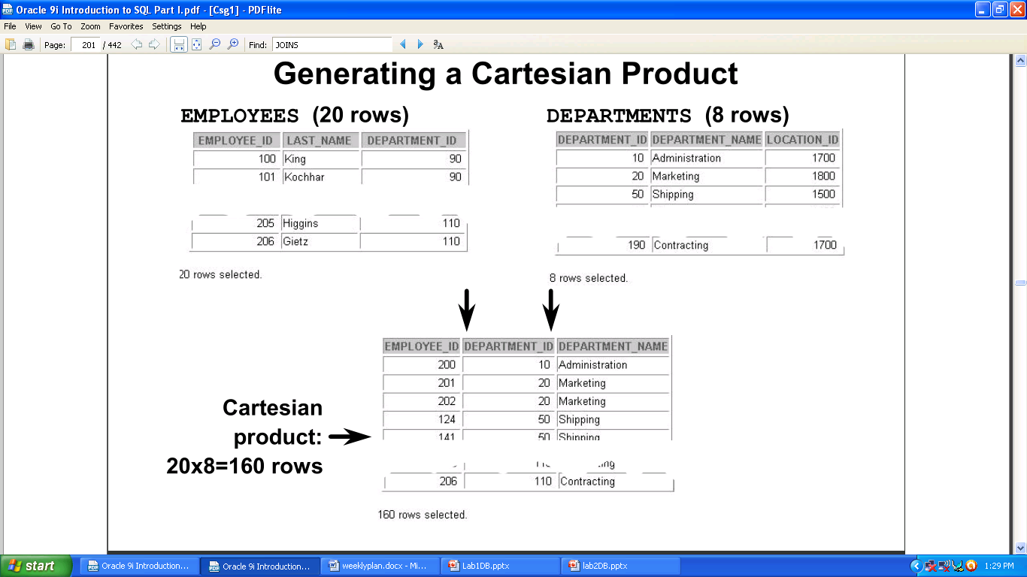
CARTESIAN PRODUCT

Slide 6
TYPES OF JOINS
EQUIJOIN
NON EQUIJOIN
OUTER JOIN
RIGHT OUTER JOIN
LEFT OUTER JOIN
FULL OUTER JOIN
SELF JOIN

Slide 7
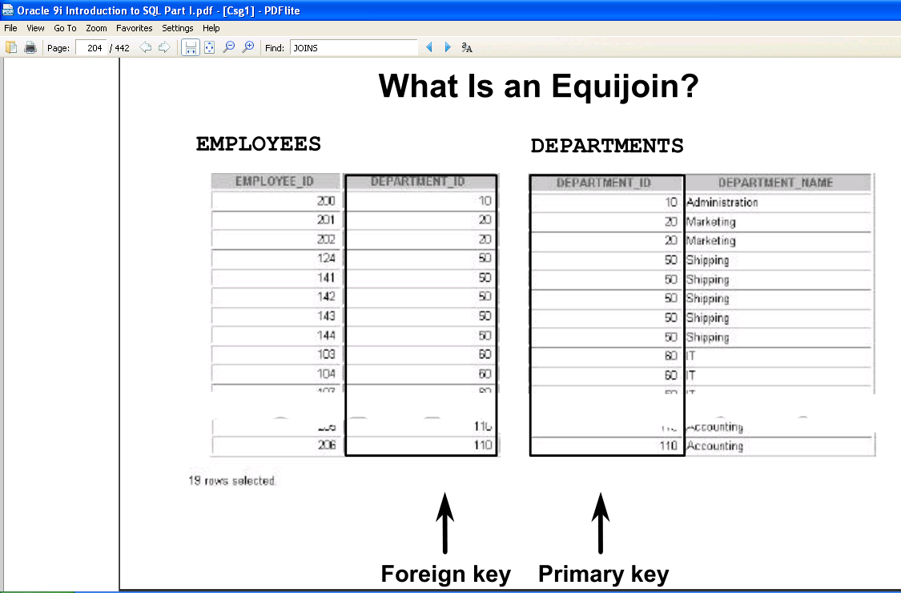
1. EQUI JOIN

Slide 8
RETRIEVING RECORDS WITH EQUI JOIN
SELECT
E.EMPNO , E.ENAME , E.DEPTNO , D.DNAME,D.DEPTNO,D.LOC
FROM
EMP E , DEPT D
WHERE
E.DEPTNO = D.DEPTNO

Slide 9
ADDITIONAL SEARCH CONDITIONS
SELECT
E.ENAME,D.DEPTNO
FROM
EMP E , DEPT D
WHERE
E.DEPTNO = D.DEPT
AND
ENAME = ‘MILLAR’;

Slide 10
2) NON EQUIJOIN
NON EQUIJOIN IS A JOIN CONDITION CONTAINING SOMETHING OTHER THAN EQUALITY OPERATOR

Slide 11
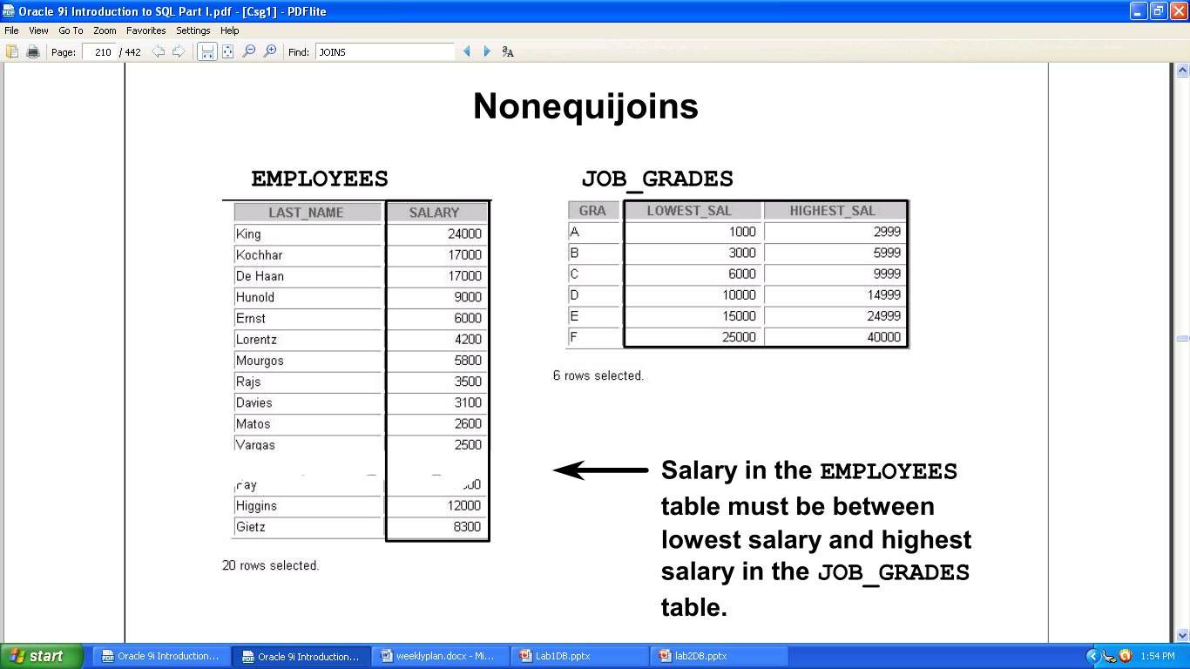

Slide 12
RETRIEVE RECORD FROM NONEQUI-JOINS
SELECT
E.ENAME, E.SAL, S.GRADE
FROM
EMP E , SALGRADE S
WHERE
E.SAL BETWEEN S.LOSAL AND S.HISAL

Slide 13
3) OUTER JOINS
YOU USE AN OUTER JOIN TO ALSO SEE ROWS THAT DO NOT MEET THE JOIN CONDITION.
THE OUTER JOIN OPERATOR IS THE PLUS SIGN(+)

Slide 14
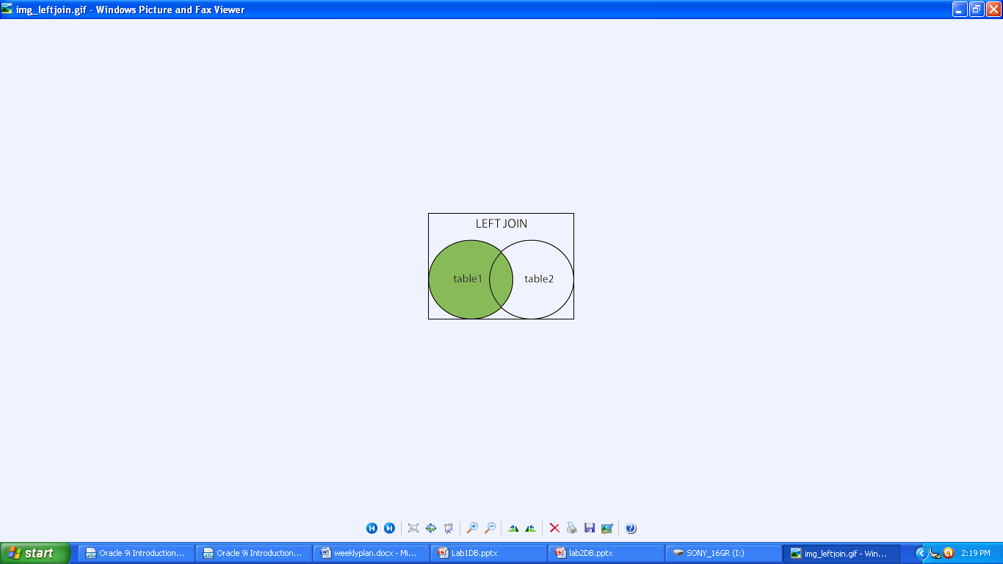
I. LEFT OUTER JOIN

Slide 15
HOW TO RETRIEVE RECORDS USING LEFT OUTER JOIN??
SELECT
E.ENAME , E.DEPTNO , D.DNAME
FROM
EMP E , DEPT D
WHERE
E.DEPTNO (+) = D.DEPTNO;
NOTE: The outer join operator appears on only that side that has information missing.

Slide 16
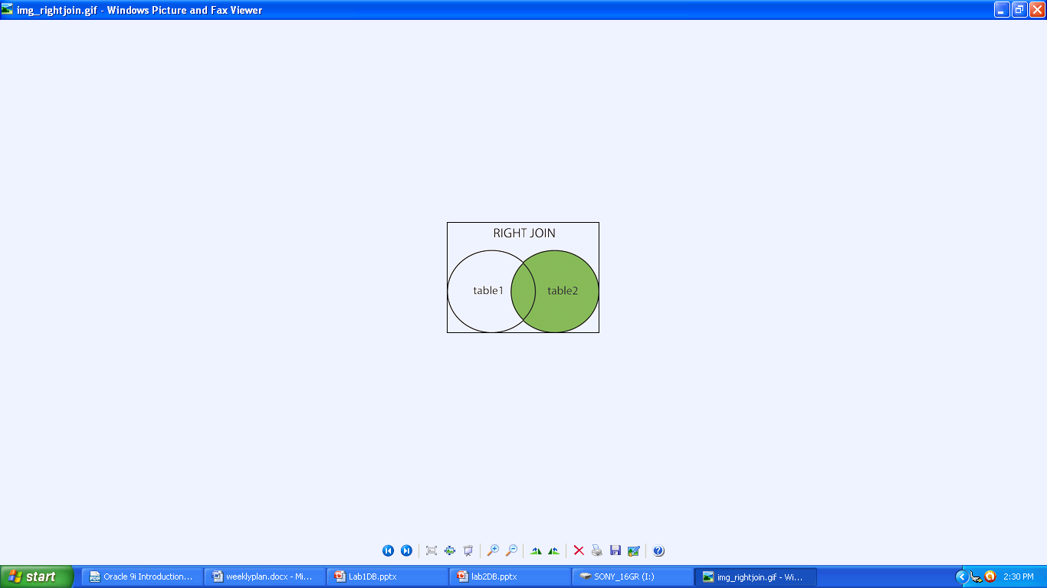
II. RIGHT OUTER JOIN

Slide 17
HOW TO RETRIEVE RECORDS USING RIGHT OUTER JOIN??
SELECT
E.ENAME , E.DEPTNO , D.DNAME
FROM
EMP E , DEPT D
WHERE
E.DEPTNO = D.DEPTNO (+)

Slide 18
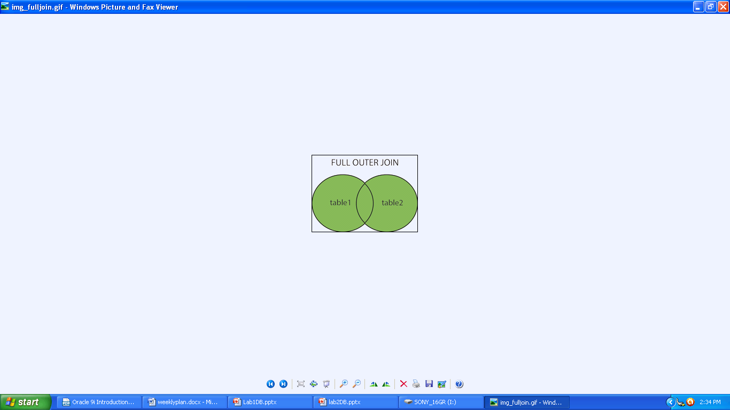
III. FULL OUTER JOIN

Slide 19
HOW TO RETRIEVE RECORDS USING FULL OUTER JOIN??
SELECT
E.ENAME , E.DEPTNO , D.DNAME
FROM
EMP E
FULL OUTER JOIN
DEPT D
ON
E.DEPTNO = D.DEPTNO

Slide 20
4) SELF JOIN
SELECT
E.ENAME AS EMPLOYEE_NAME ,M.ENAME AS MANAGER_NAME
FROM
EMP E , EMP M
WHERE
E.EMPNO = M.MGR

Slide 21
SET OPERATORS

Slide 22
Set Operators
A
B
A
B
UNION/UNION ALL
A
B
INTERSECT
A
B
MINUS
Notes:
Set Operators
The set operators combine the results of two or more component queries into one result. Queries containing set operators are called compound queries.
All set operators have equal precedence. If a SQL statement contains multiple set operators, the Oracle server evaluates them from left (top) to right (bottom) if no parentheses explicitly specify another order. You should use parentheses to specify the order of evaluation explicitly in queries that use the INTERSECT operator with other set operators.

Slide 23
Tables Used in This Lesson
The tables used in this lesson are:
EMPLOYEES: Provides details regarding all current employees
JOB_HISTORY: Records the details of the start date and end date of the former job, and the job identification number and department when an employee switches jobs
Notes:
Tables Used in This Lesson
Two tables are used in this lesson. They are the EMPLOYEES table and the JOB_HISTORY table.
The EMPLOYEES table stores the employee details. For the human resource records, this table stores a unique identification number and e-mail address for each employee. The details of the employee’s job identification number, salary, and manager are also stored. Some of the employees earn a commission in addition to their salary; this information is tracked, too. The company organizes the roles of employees into jobs. Some of the employees have been with the company for a long time and have switched to different jobs. This is monitored using the JOB_HISTORY table. When an employee switches jobs, the details of the start date and end date of the former job, the job identification number, and the department are recorded in the JOB_HISTORY table.
The structure and data from the EMPLOYEES and JOB_HISTORY tables are shown on the following pages.

Slide 24
UNION Operator
A
B
The UNION operator returns results from both queries after eliminating duplications.
Notes:
UNION Operator
The UNION operator returns all rows that are selected by either query. Use the UNION operator to return all rows from multiple tables and eliminate any duplicate rows.
Guidelines
The number of columns and the data types of the columns being selected must be identical in all the SELECT statements used in the query. The names of the columns need not be identical.
UNION operates over all of the columns being selected.
NULL values are not ignored during duplicate checking.
The IN operator has a higher precedence than the UNION operator.
By default, the output is sorted in ascending order of the first column of the SELECT clause.

Slide 25

Using the UNION Operator
Display the current and previous job details of all employees. Display each employee only once.
SELECT employee_id, job_id
FROM employees
UNION
SELECT employee_id, job_id
FROM job_history;
…
…
Notes:
Using the UNION Operator
The UNION operator eliminates any duplicate records. If records that occur in both the EMPLOYEES and the JOB_HISTORY tables are identical, the records are displayed only once. Observe in the output shown on the slide that the record for the employee with the EMPLOYEE_ID 200 appears twice because the JOB_ID is different in each row.
Consider the following example:
SELECT employee_id, job_id, department_id
FROM employees
UNION
SELECT employee_id, job_id, department_id
FROM job_history;

Slide 26
UNION ALL Operator
A
B
The UNION ALL operator returns results from both queries, including all duplications.
Notes:
UNION ALL Operator
Use the UNION ALL operator to return all rows from multiple queries.
Guidelines
The guidelines for UNION and UNION ALL are the same, with the following two exceptions that pertain to UNION ALL:
Unlike UNION, duplicate rows are not eliminated and the output is not sorted by default.
The DISTINCT keyword cannot be used.

Slide 27

Using the UNION ALL Operator
Display the current and previous departments of all employees.
SELECT employee_id, job_id, department_id
FROM employees
UNION ALL
SELECT employee_id, job_id, department_id
FROM job_history
ORDER BY employee_id;
…
…
Notes:
UNION ALL Operator (continued)
In the example, 30 rows are selected. The combination of the two tables totals to 30 rows. The UNION ALL operator does not eliminate duplicate rows. UNION returns all distinct rows selected by either query. UNION ALL returns all rows selected by either query, including all duplicates. Consider the query on the slide, now written with the UNION clause:
SELECT employee_id, job_id,department_id FROM employees UNION SELECT employee_id, job_id,department_id FROM job_history ORDER BY employee_id;
The preceding query returns 29 rows. This is because it eliminates the following row (as it is a duplicate):

Slide 28
INTERSECT Operator
A
B
The INTERSECT operator returns rows that are common to both queries.
Notes:
INTERSECT Operator
Use the INTERSECT operator to return all rows that are common to multiple queries.
Guidelines
The number of columns and the data types of the columns being selected by the SELECT statements in the queries must be identical in all the SELECT statements used in the query. The names of the columns need not be identical.
Reversing the order of the intersected tables does not alter the result.
INTERSECT does not ignore NULL values.

Slide 29

Using the INTERSECT Operator
Display the employee IDs and job IDs of those employees who currently have a job title that is the same as their job title when they were initially hired (that is, they changed jobs but have now gone back to doing their original job).
SELECT employee_id, job_id
FROM employees
INTERSECT
SELECT employee_id, job_id
FROM job_history;
Notes:
INTERSECT Operator (continued)
In the example in this slide, the query returns only the records that have the same values in the selected columns in both tables.
What will be the results if you add the DEPARTMENT_ID column to the SELECT statement from the EMPLOYEES table and add the DEPARTMENT_ID column to the SELECT statement from the JOB_HISTORY table and run this query? The results may be different because of the introduction of another column whose values may or may not be duplicates.
Example
SELECT employee_id, job_id, department_id
FROM employees
INTERSECT
SELECT employee_id, job_id, department_id
FROM job_history;
Employee 200 is no longer part of the results because the EMPLOYEES.DEPARTMENT_ID value is different from the JOB_HISTORY.DEPARTMENT_ID value.

Slide 30
MINUS Operator
A
B
The MINUS operator returns rows in the first query that are not present in the second query.
Notes:
MINUS Operator
Use the MINUS operator to return rows returned by the first query that are not present in the second query (the first SELECT statement MINUS the second SELECT statement).
Guidelines
The number of columns and the data types of the columns being selected by the SELECT statements in the queries must be identical in all the SELECT statements used in the query. The names of the columns need not be identical.
All of the columns in the WHERE clause must be in the SELECT clause for the MINUS operator to work.

Slide 31
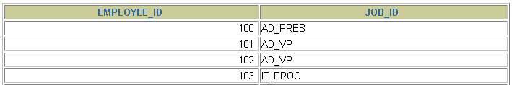

MINUS Operator
Display the employee IDs of those employees who have not changed their jobs even once.
SELECT employee_id,job_id
FROM employees
MINUS
SELECT employee_id,job_id
FROM job_history;
…
Notes:
MINUS Operator (continued)
In the example in the slide, the employee IDs and job IDs in the JOB_HISTORY table are subtracted from those in the EMPLOYEES table. The results set displays the employees remaining after the subtraction; they are represented by rows that exist in the EMPLOYEES table but do not exist in the JOB_HISTORY table. These are the records of the employees who have not changed their jobs even once.

Slide 32
Set Operator Guidelines
The expressions in the SELECT lists must match in number and data type.
The ORDER BY clause:
Can appear only at the very end of the statement
Will accept the column name, aliases from the first SELECT statement
Notes:
Set Operator Guidelines
The expressions in the select lists of the queries must match in number and data type. Queries that use UNION, UNION ALL, INTERSECT, and MINUS operators in their WHERE clause must have the same number and type of columns in their SELECT list. For example:
SELECT employee_id, department_id
FROM employees
WHERE (employee_id, department_id)
IN (SELECT employee_id, department_id
FROM employees
UNION
SELECT employee_id, department_id
FROM job_history);
The ORDER BY clause:
Can appear only at the very end of the statement
Will accept the column name, an alias, or the positional notation
The column name or alias, if used in an ORDER BY clause, must be from the first SELECT list.
Set operators can be used in subqueries.

